Slide 1
HR ANALYTICS
BY
SHAKTI ANAND

Slide 2
AGENDA
Business Task
Data Sources
Visualizations & Insights
Dashboard
Recommendations

Slide 3
BUSINESS TASK
Employee Attrition is the gradual workforce reduction when employees leave and their roles remains unfilled.
The goal is to analyze employee attrition patterns and uncover various demographic, job and performance factors driving employee attrition.

Slide 4
DATA SOURCES
Kaggle IBM HR Analytics Employee Attrition Performance Dataset (Public Domain).
The IBM HR Analytics Dataset is a fictional and synthetic dataset, anonymized by IBM data scientists. This dataset contains employee information such as age, gender, education, department, job role, employee performance, work–life balance, travel requirements, survey scores.

Slide 5
UNDERSTANDING THE DATA
Total Employees 1,470
Attrition 237
Active Employees 1,233
Attrition Rate 16.12%

Slide 6
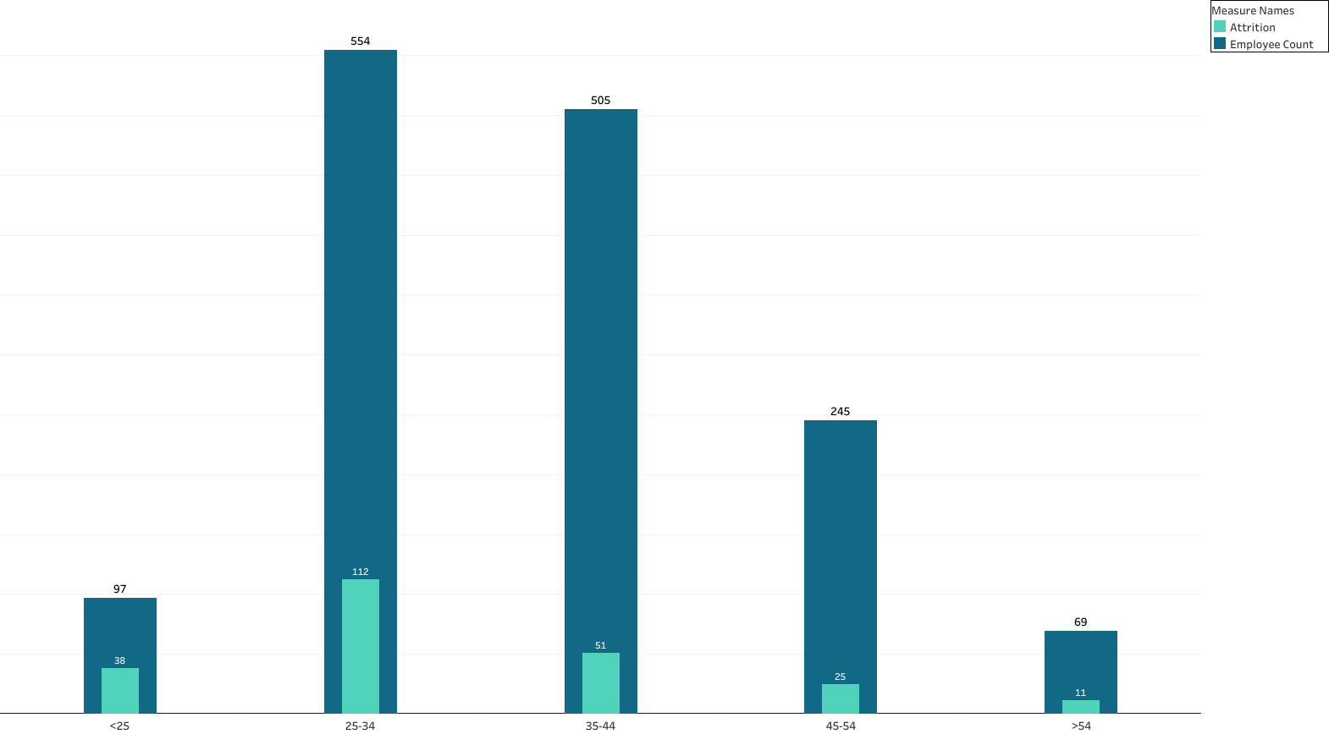
ATTRITION BY AGE GROUP
Attrition is highest among the younger age group of employees, indicative of employees seeking career progression or exploration.

Slide 7
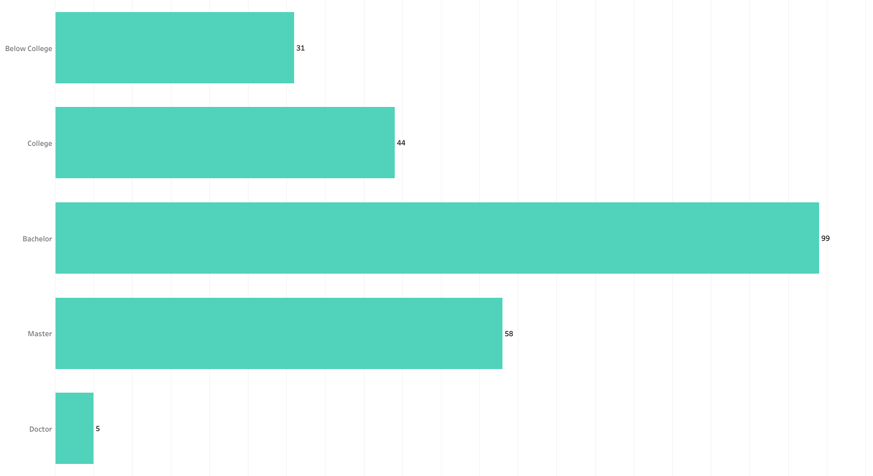
ATTRITION BY EDUCATION
Bachelor's degree holders account for the highest number of attrition (99), while employees with only secondary or technical education (Below College) have highest share of attrition (18.23%).

Slide 8
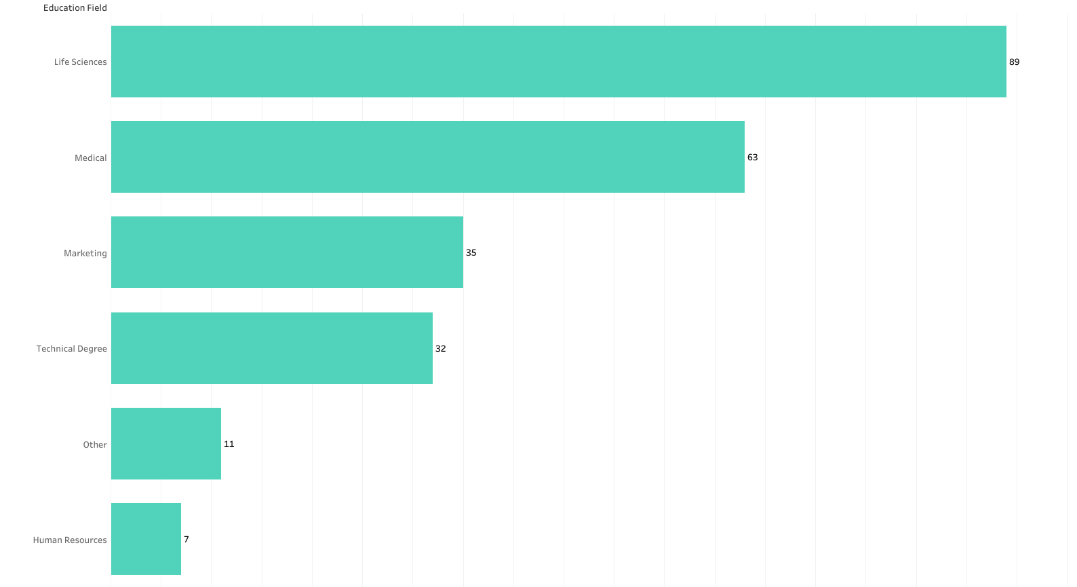
ATTRITION BY EDUCATION FIELD
Employees from Life Sciences stream show the highest number of attrition, but employees who studied Human Resources contribute to 25.9% of attrition among all education field.

Slide 9
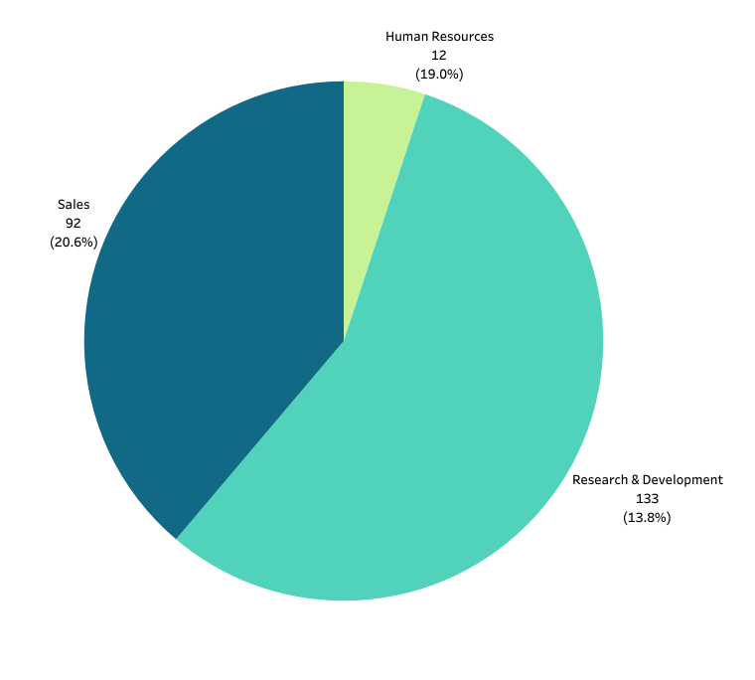
ATTRITION BY DEPARTMENT
Research & Development department has highest workforce count of 961 employees and records highest attrition count of 133.
In contrast, the Sales department records highest attrition rate of 20.62% of its department's workforce.

Slide 10
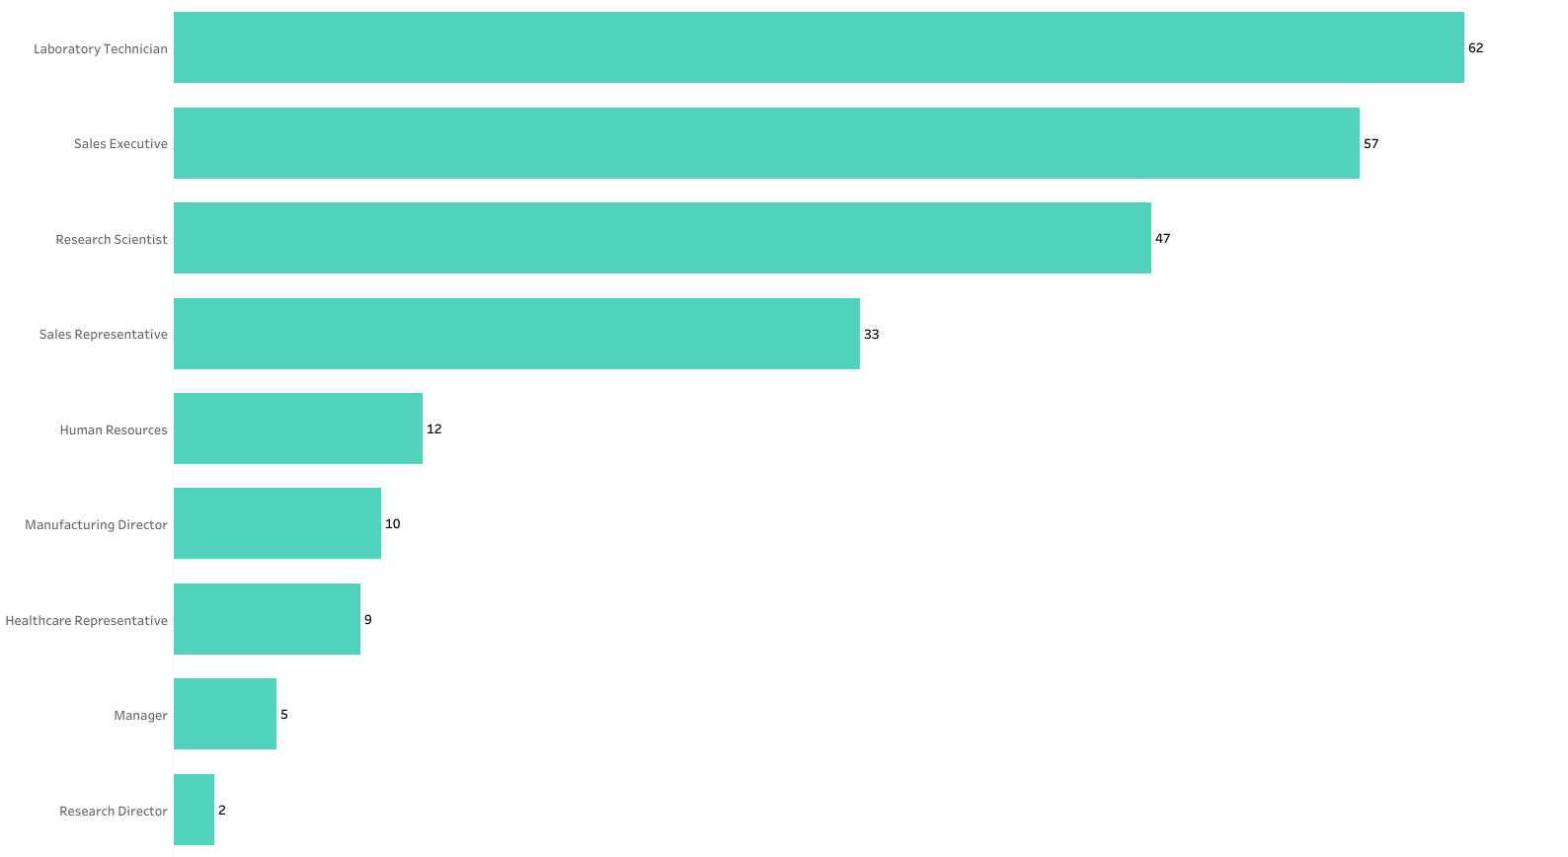
ATTRITION BY JOB ROLE
Sales Executives and Laboratory Technicians show the highest attrition among all roles across the company, indicative of higher attrition at the lower end of the organizational hierarchy.

Slide 11
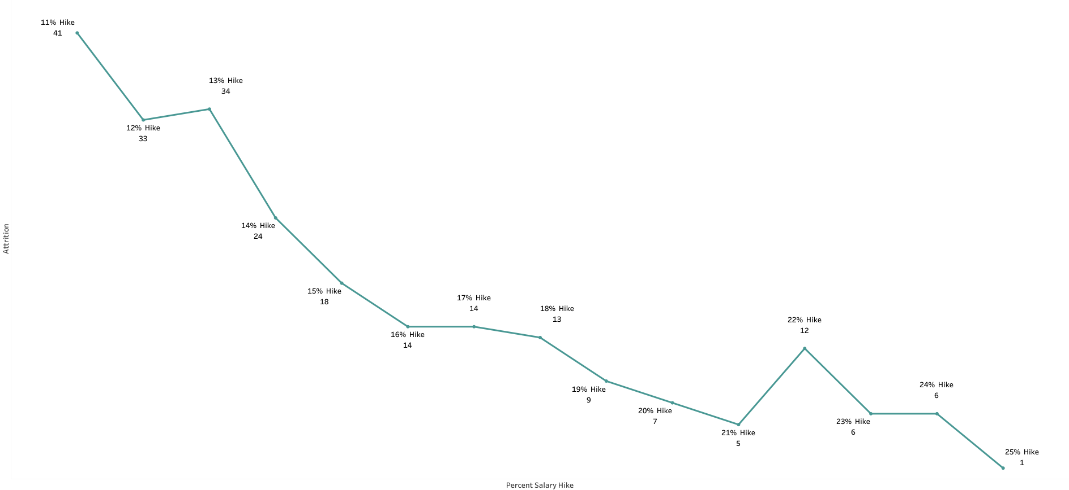
ATTRITION BY SALARY HIKE
Employees with a lower salary hike show higher attrition in comparison to employees receiving greater salary hike, suggesting that consistent pay growth contributes to employee retention.

Slide 12
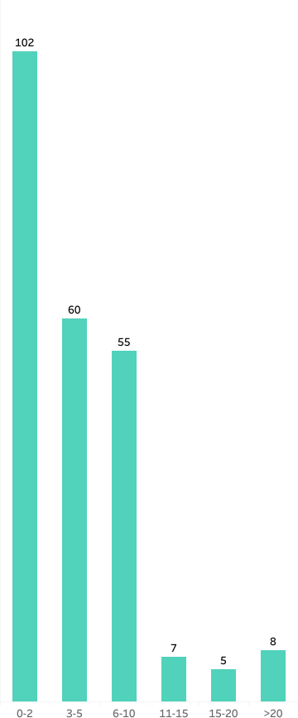
ATTRITION BY YEARS AT COMPANY
Attrition is highest among employees with 0–2 years of tenure and declines significantly in later years, highlighting the importance of strengthening retention strategies during the early years of employment.

Slide 13
ATTRITION BY WORK-LIFE BALANCE
Attrition is concentrated among employees experiencing a moderate level of work-life balance, indicative of various other factors such as environment satisfaction, career progression and growth playing a significant role in driving attrition.

Slide 14



SURVEY SCORES
Environment Satisfaction – 48.5% of employees leaving by attrition experience low-to-medium environment satisfaction within the company.
Job Satisfaction – Attrition is concentrated at extreme ends, with 30.8% of employees leaving reporting higher levels of job satisfaction. In contrast, 28% of employees reporting low level of job satisfaction.
Job Involvement - Attrition is the highest among high-performing employees, with 52.74% of employees leaving the organization having a high job involvement, suggesting a strong need to focus on talent retention.

Slide 15
INSIGHTS
Young or early–career professionals show high attrition, indicative of a cumulative effect of several factors like career alignment, growth opportunities, job expectations, workplace environment , organizational support.
Employees with lower formal education have higher attrition rates, suggesting how education levels affects growth opportunities and progression within the company.
The Department of Sales records highest attrition among all departments, suggesting potential employee dissatisfaction or high workplace pressure within the department.

Slide 16
INSIGHTS
A higher pay growth plays a significant role in employee retention.
Employees show a higher tendency of attrition during the early years of employment, suggesting initial engagement and career alignment plays a significant role in employee retention.
The workplace environment tends to be a very crucial factor in driving attrition, highlighting the impact of work culture, organizational and managerial support.

Slide 17


Slide 18
RECOMMENDATIONS
Implement structured training and upskilling programs to strengthen employee skill enhancement and support career progression.
Implement fair and competitive pay practices to encourage retention of high-performing employees.
Introduce wellness and work-life balance initiatives to reduce exhaustion and promote overall well-being.
Cultivate a positive workplace environment by encouraging healthy manager-team relationships, team interactions, and an effective grievance resolution system to address workforce challenges.

Slide 19
THANK YOU

